Slide 1

www.myBlueprint.ca

Slide 2
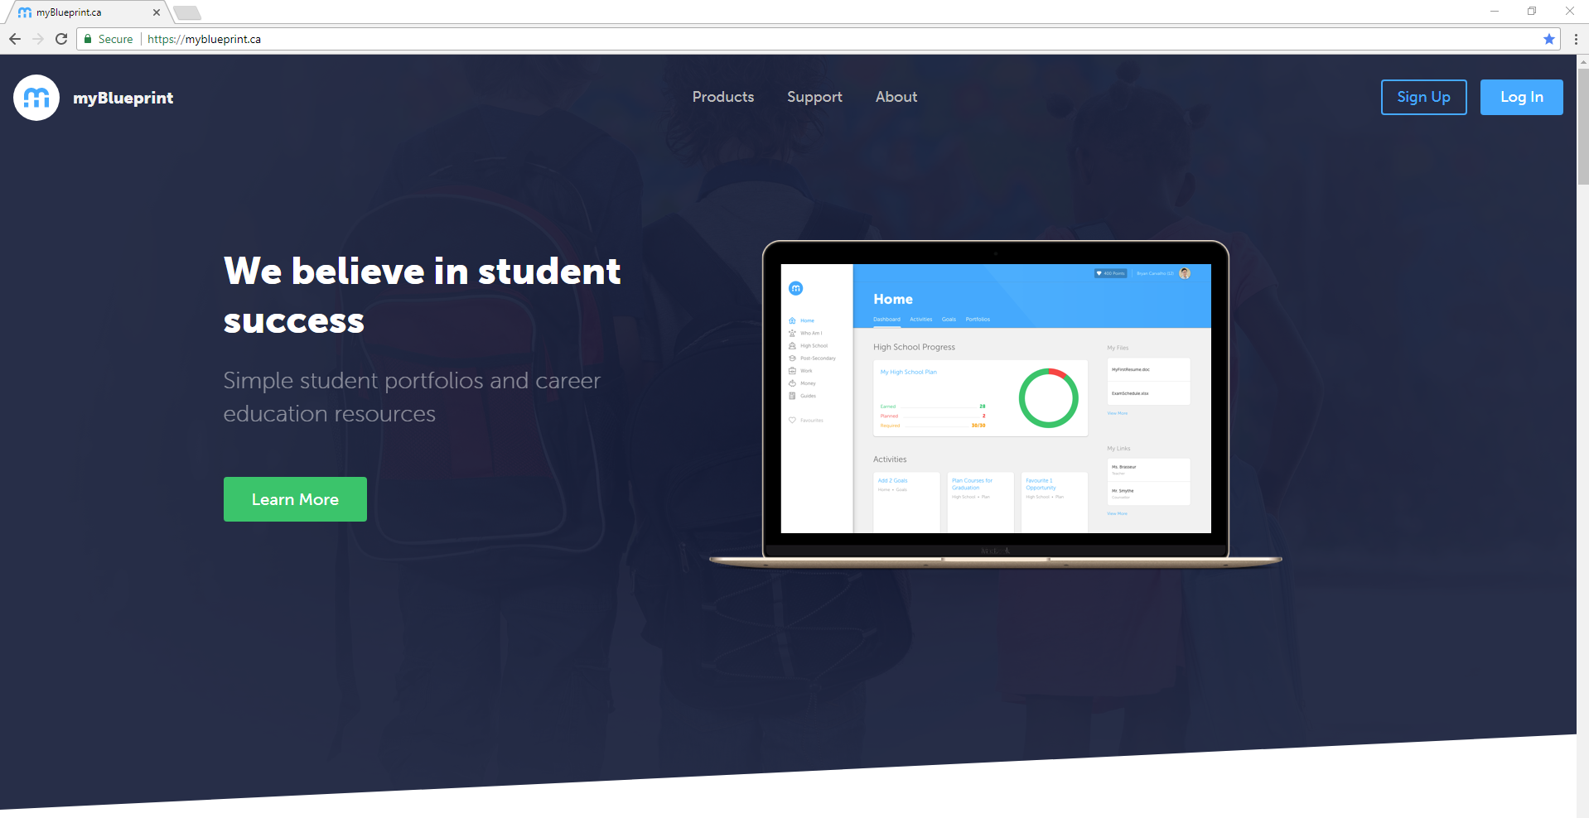
HOMEPAGE

Slide 3
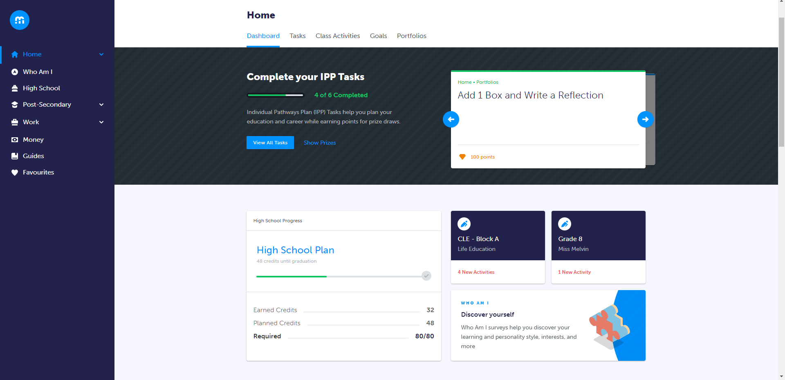
HOME  DASHBOARD

Slide 4
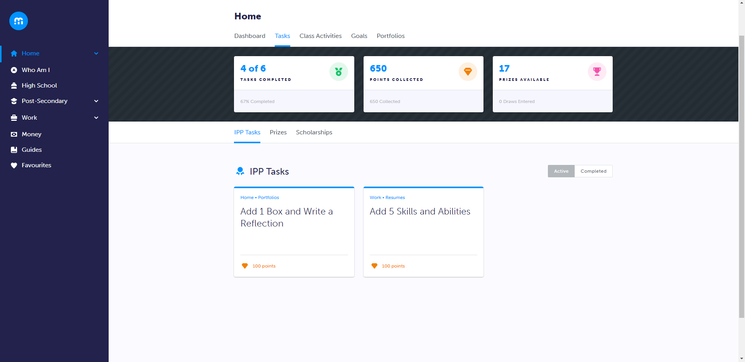
HOME  TASKS

Slide 5
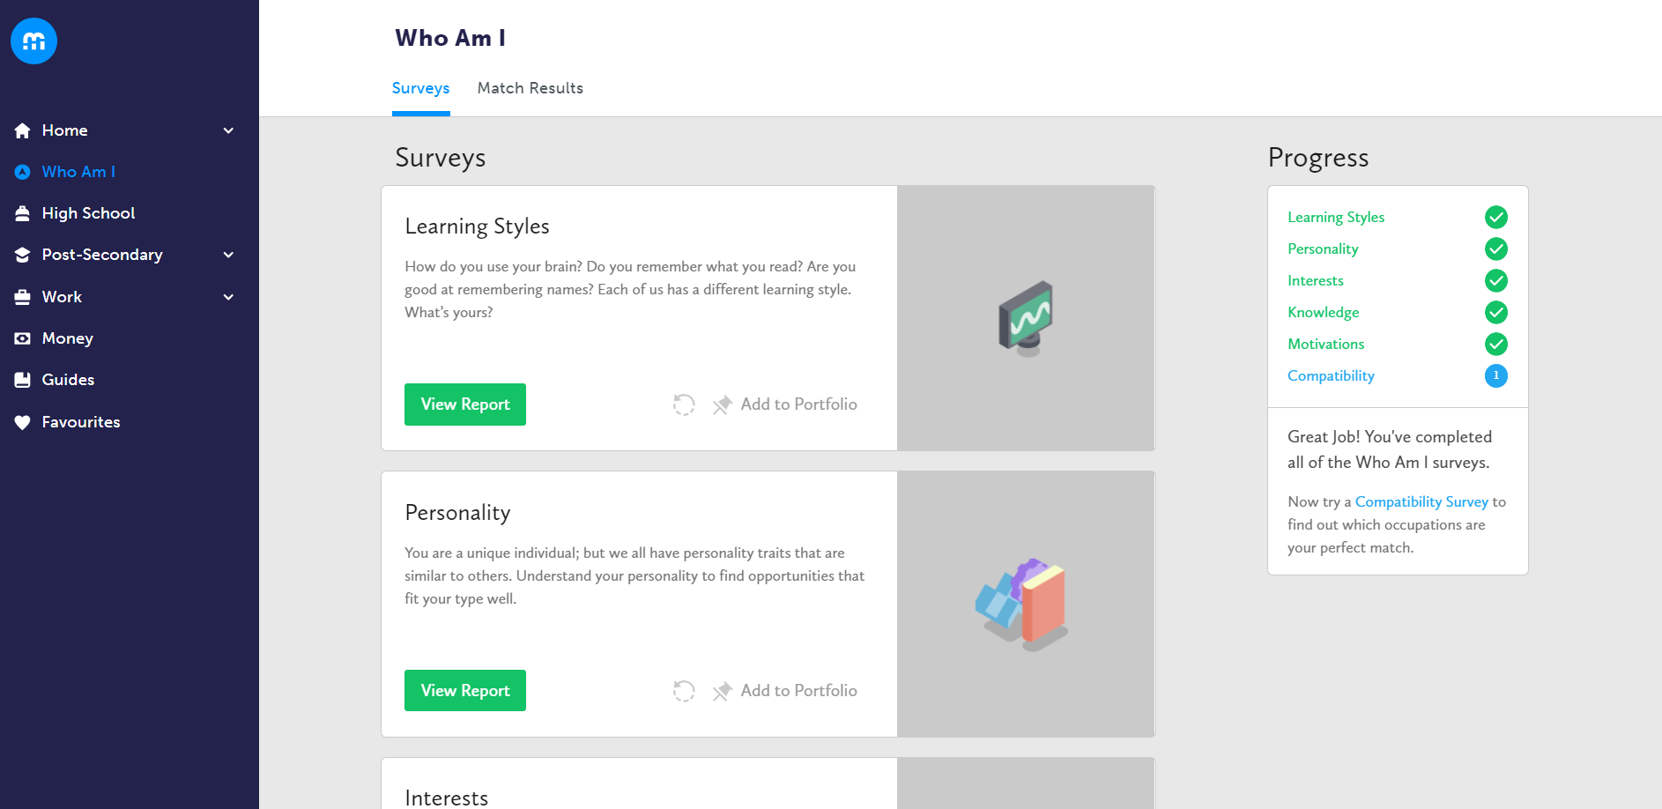
WHO AM I

Slide 6
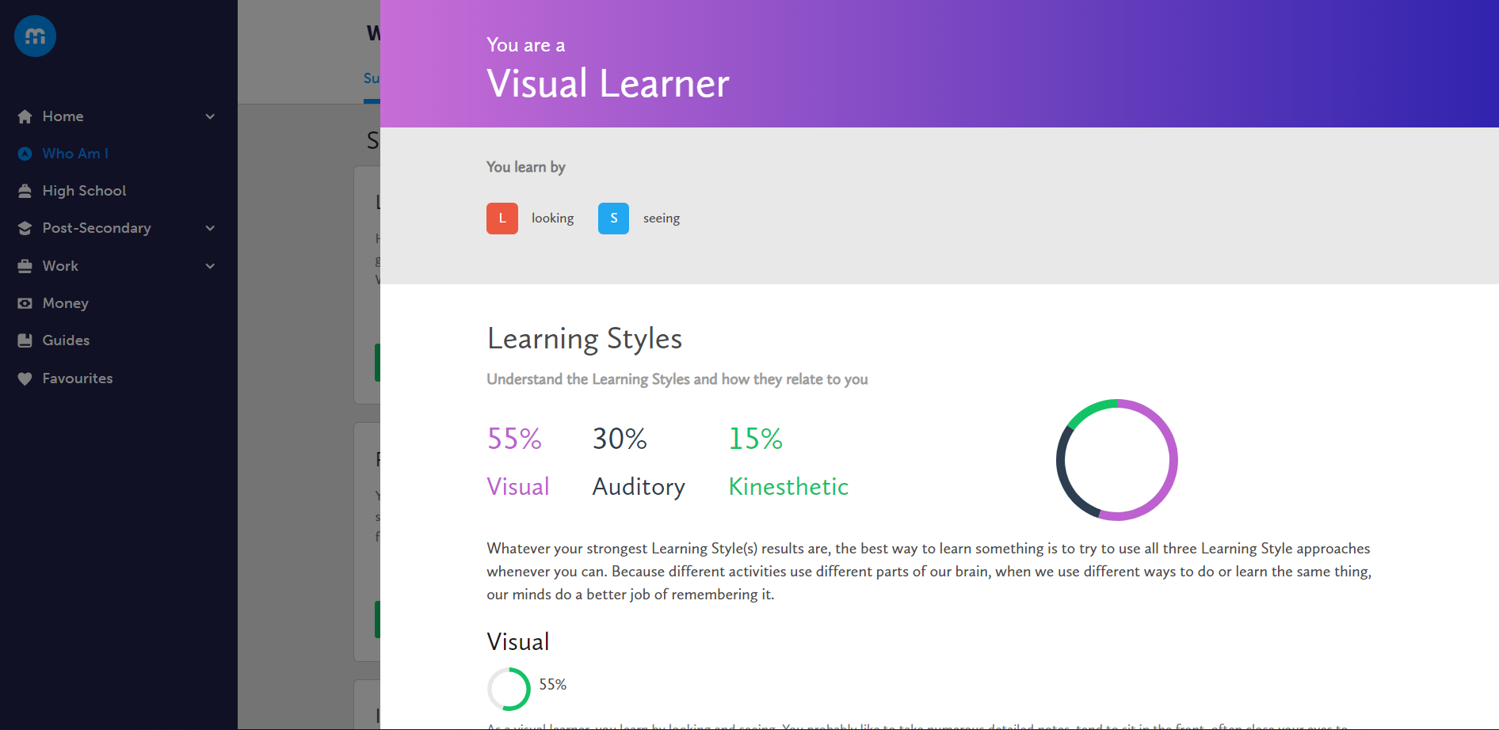
WHO AM I  LEARNING STYLES

Slide 7
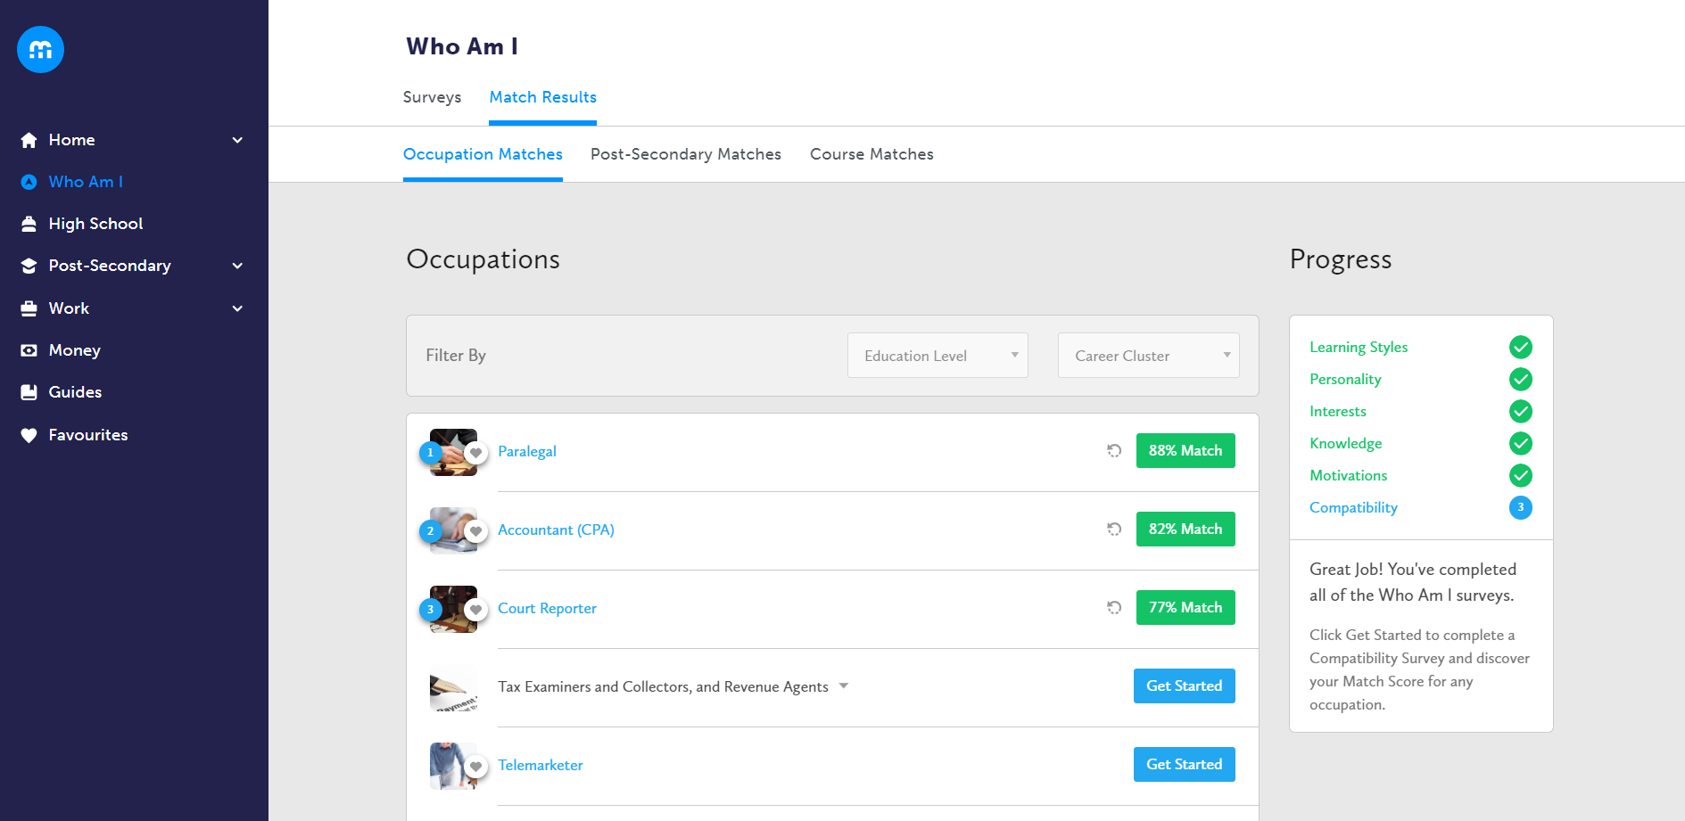
WHO AM I  COMPATIBILITY

Slide 8
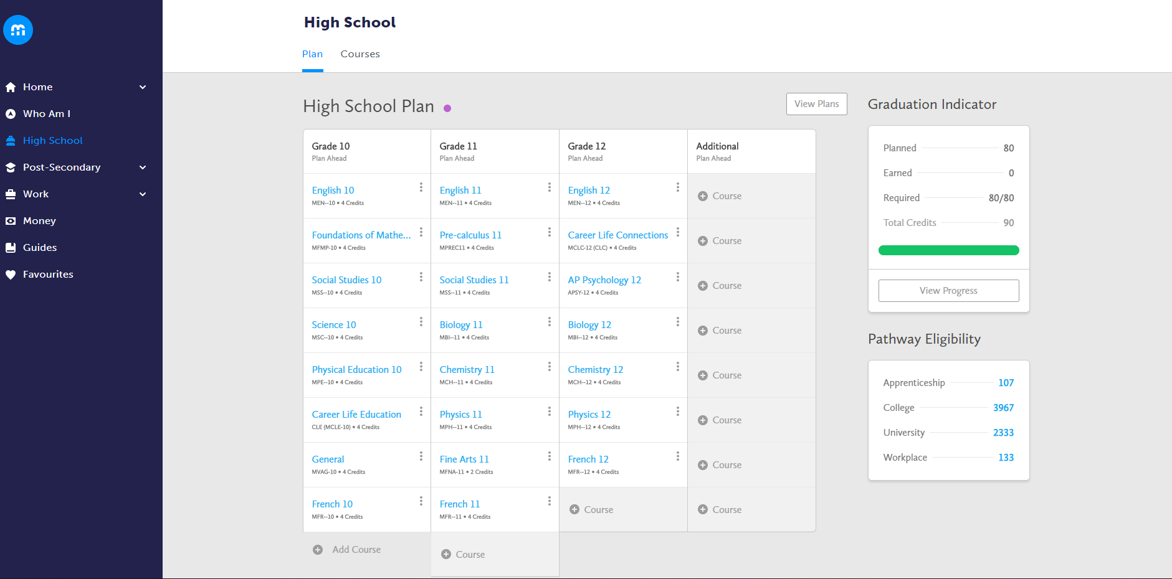
HIGH SCHOOL PLANNER

Slide 9
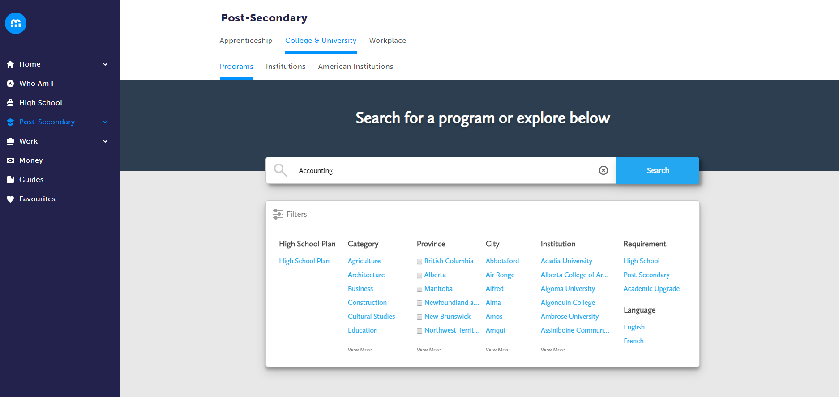
POST-SECONDARY

Slide 10
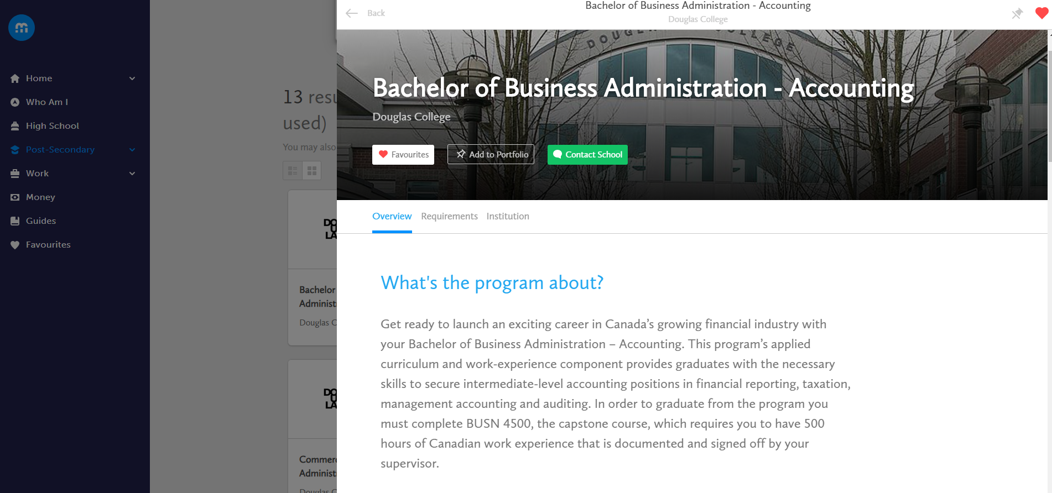
POST-SECONDARY

Slide 11
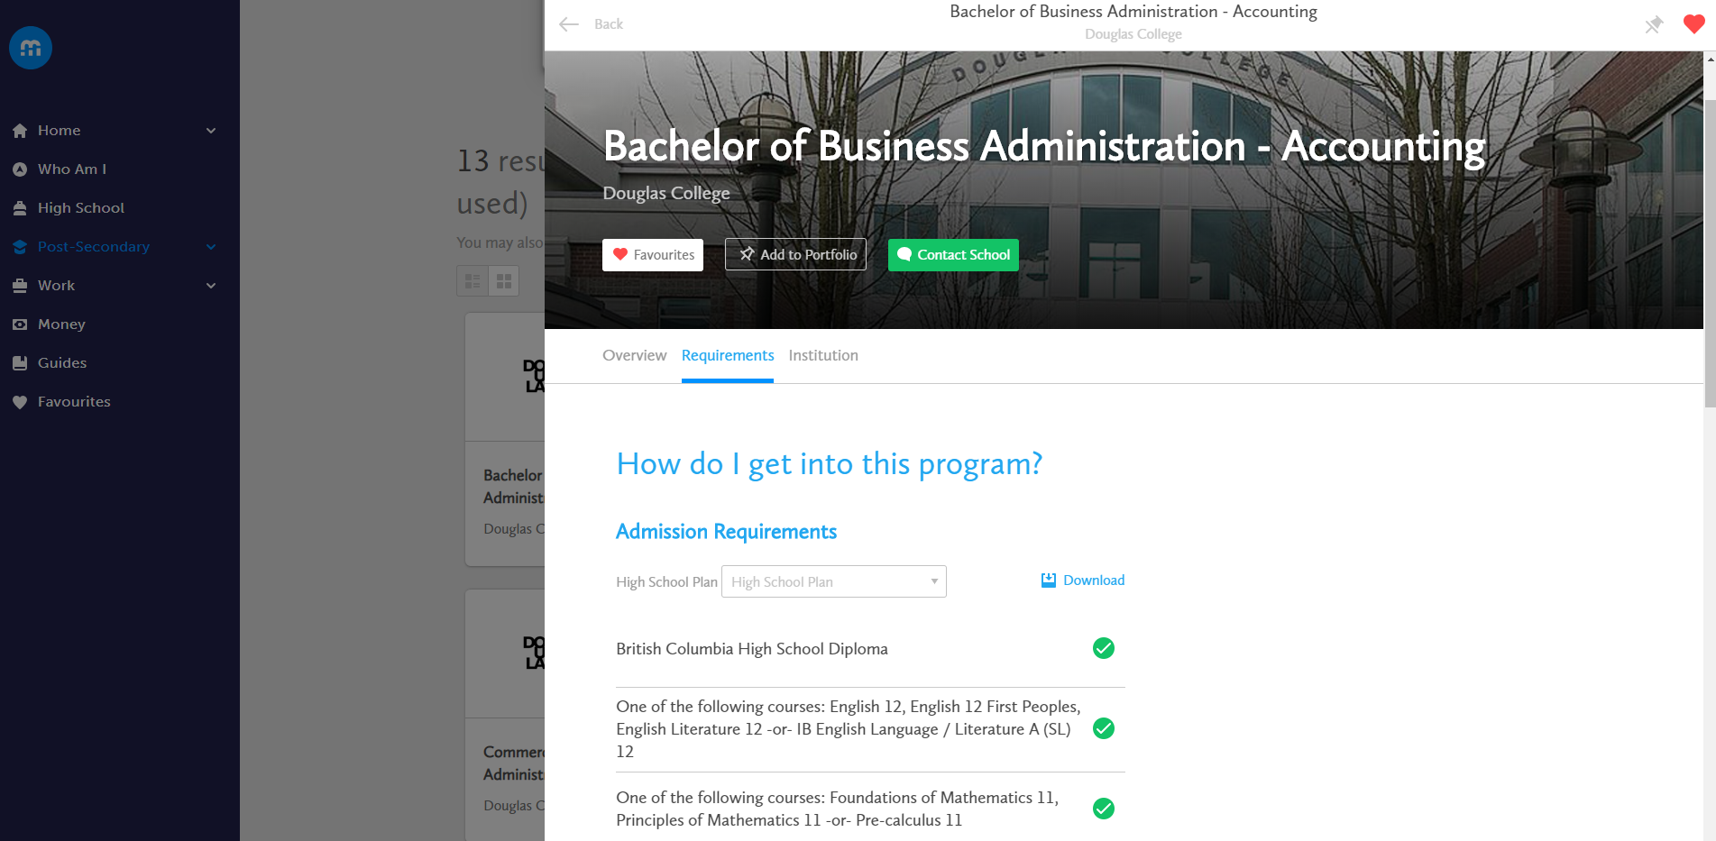
POST-SECONDARY

Slide 12
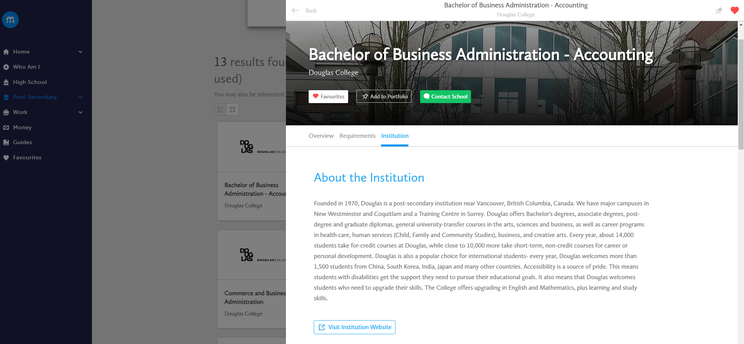
POST-SECONDARY

Slide 13
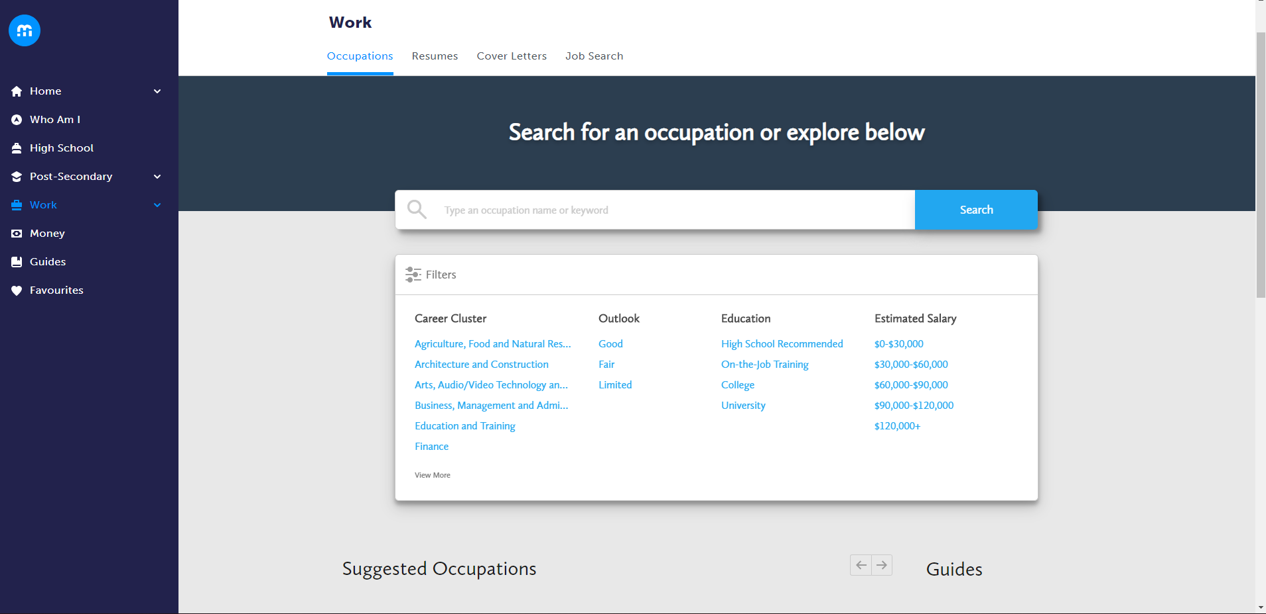
OCCUPATIONS

Slide 14
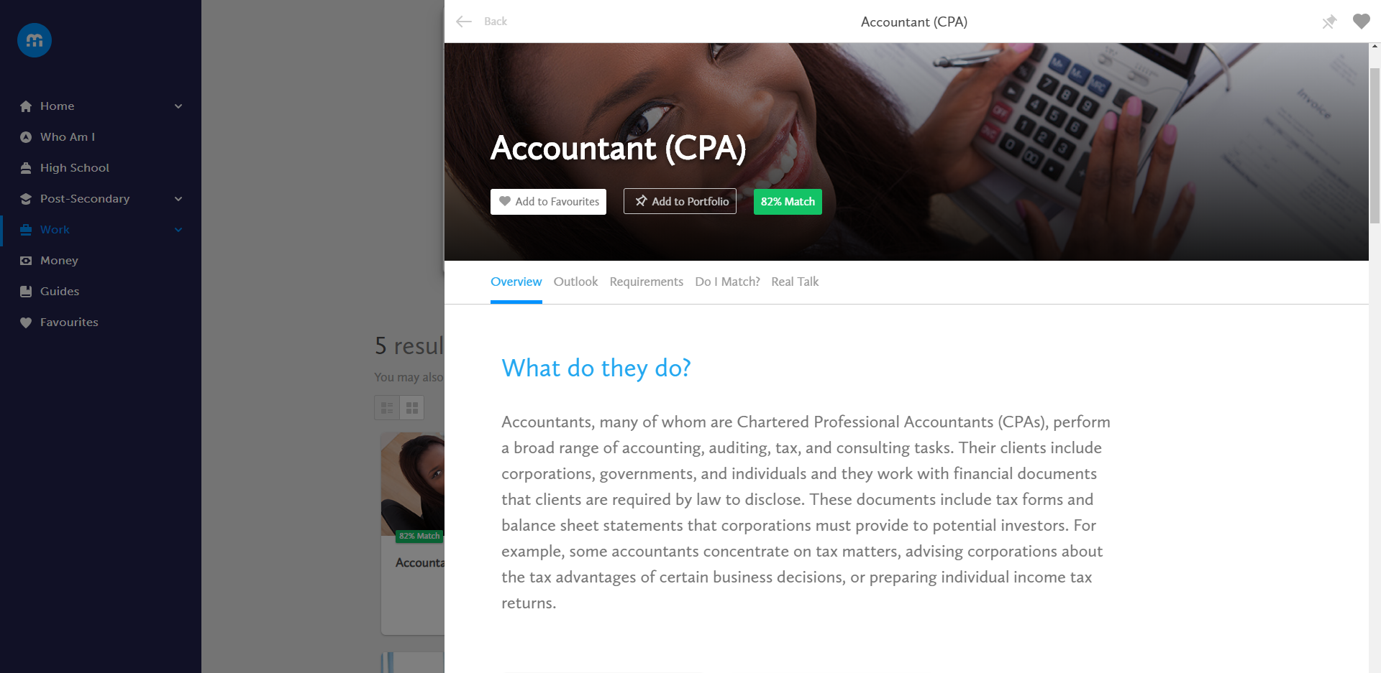
OCCUPATIONS

Slide 15
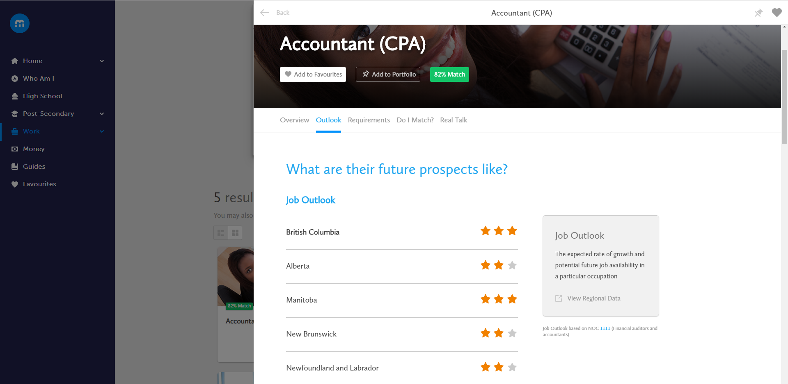
OCCUPATIONS

Slide 16
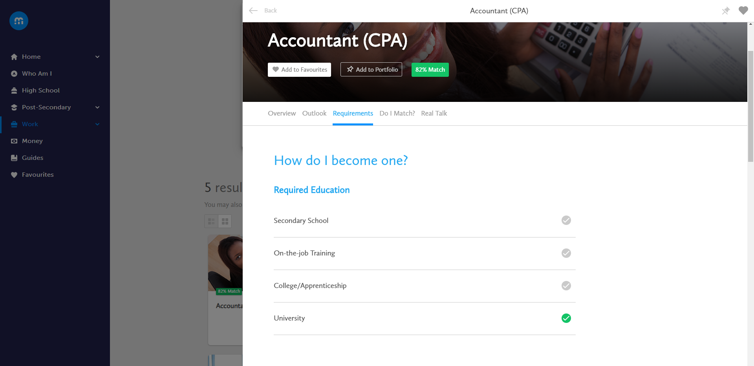
OCCUPATIONS

Slide 17
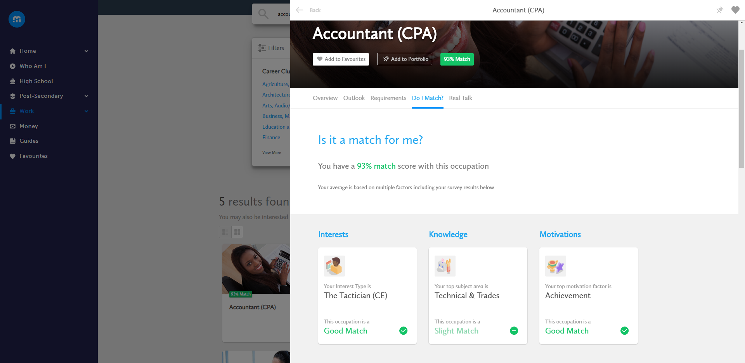
OCCUPATIONS

Slide 18
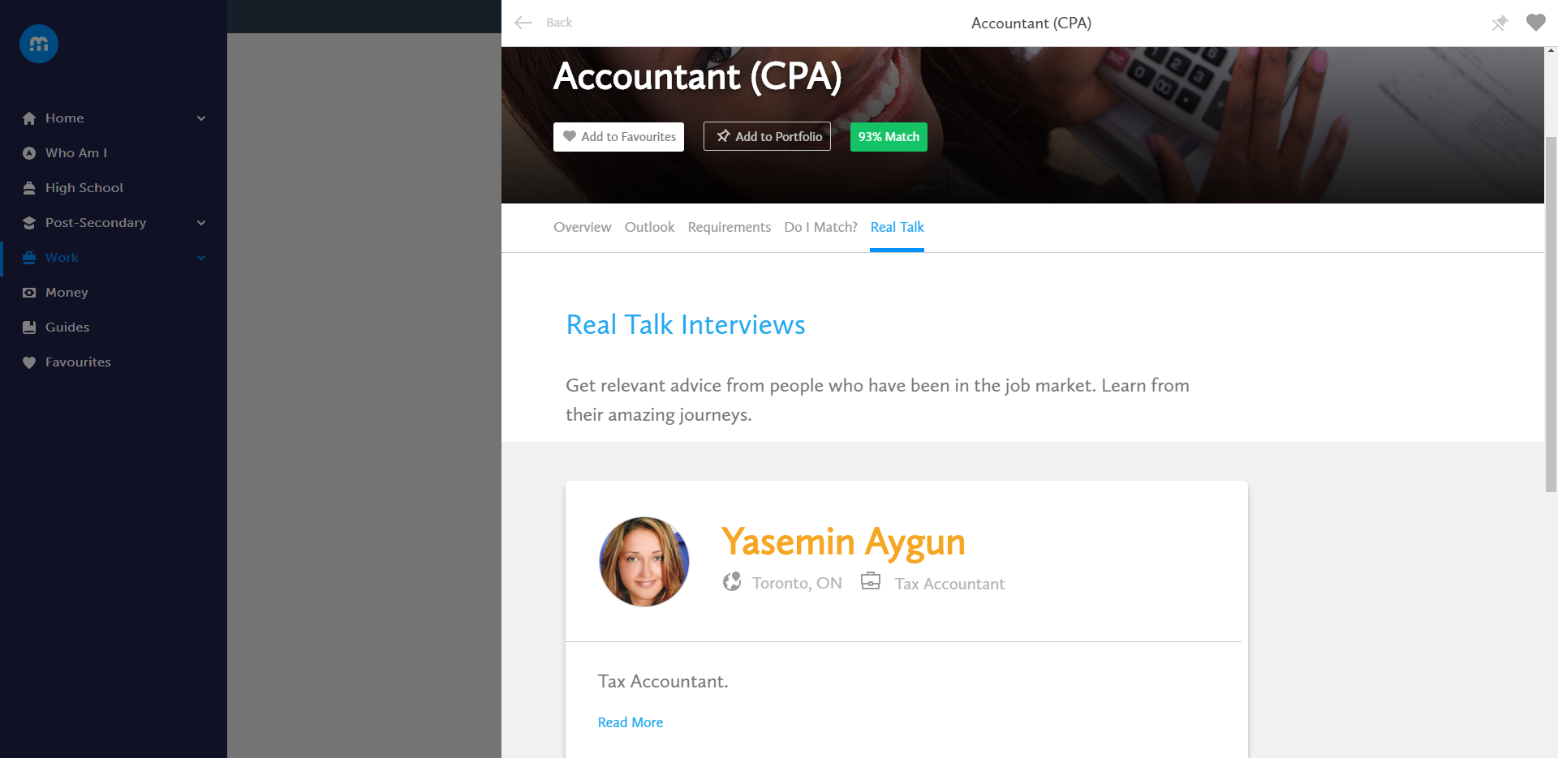
OCCUPATIONS

Slide 19
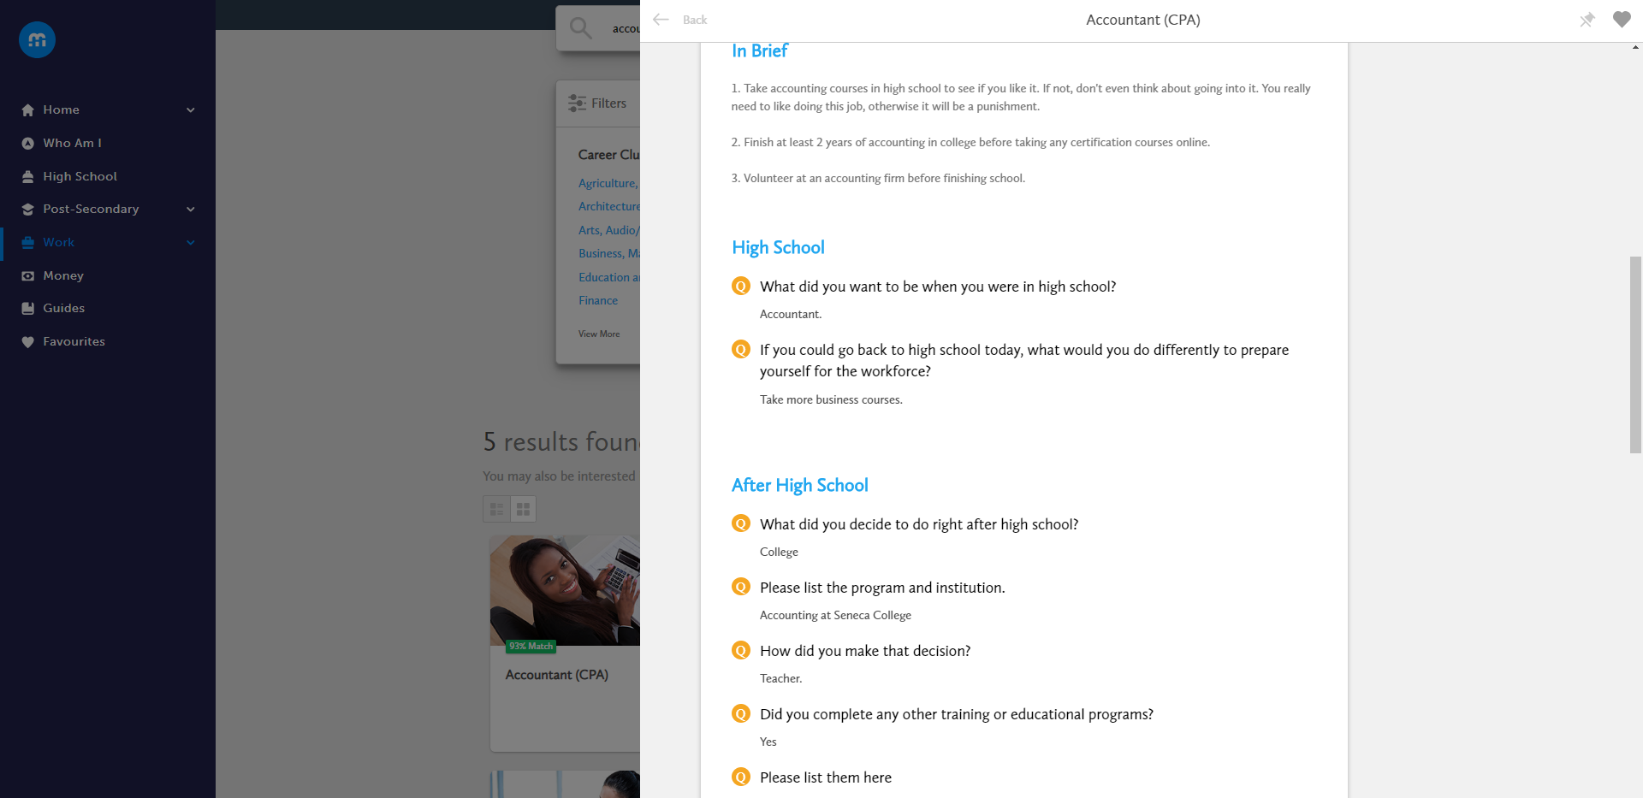
OCCUPATIONS

Slide 20
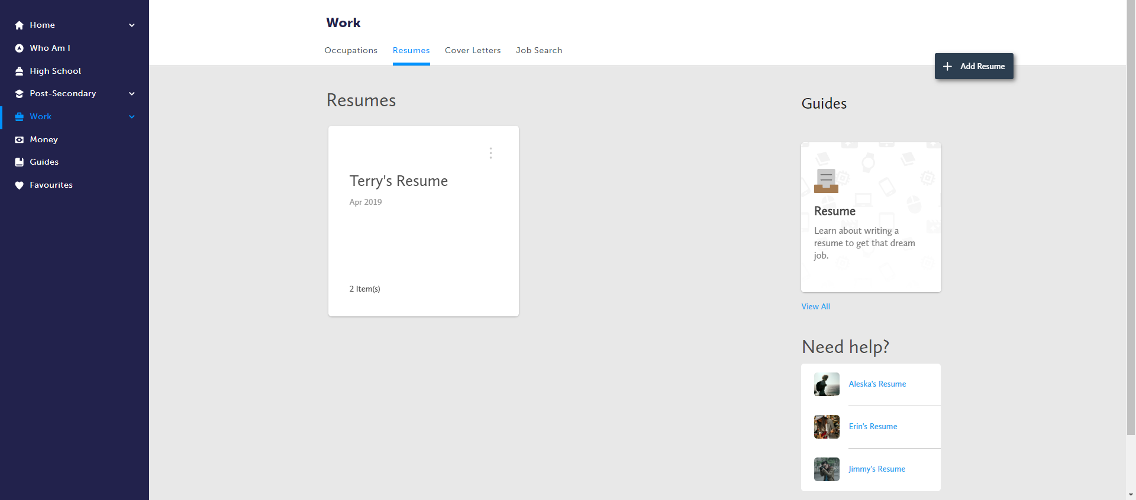
WORK  RESUMES

Slide 21
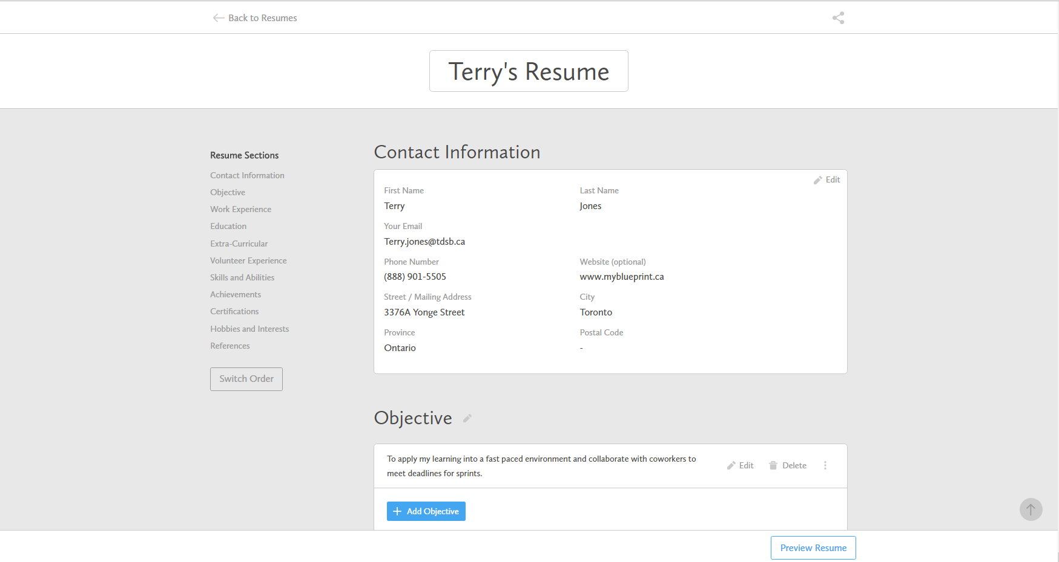
WORK  RESUMES

Slide 22
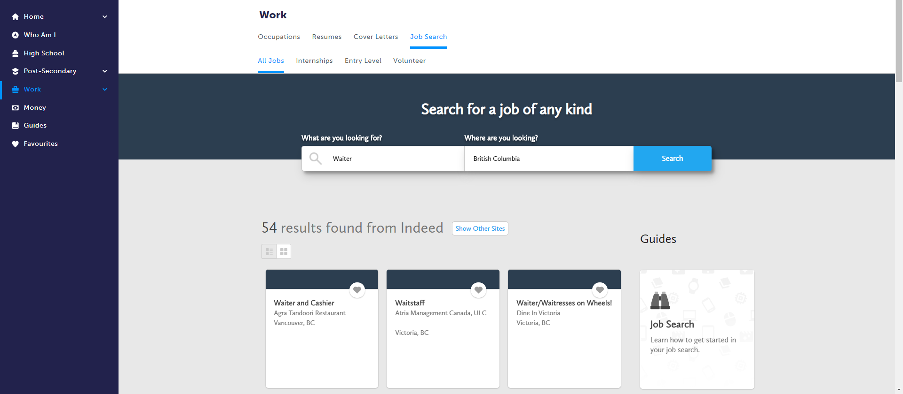
WORK  JOB SEARCH

Slide 23
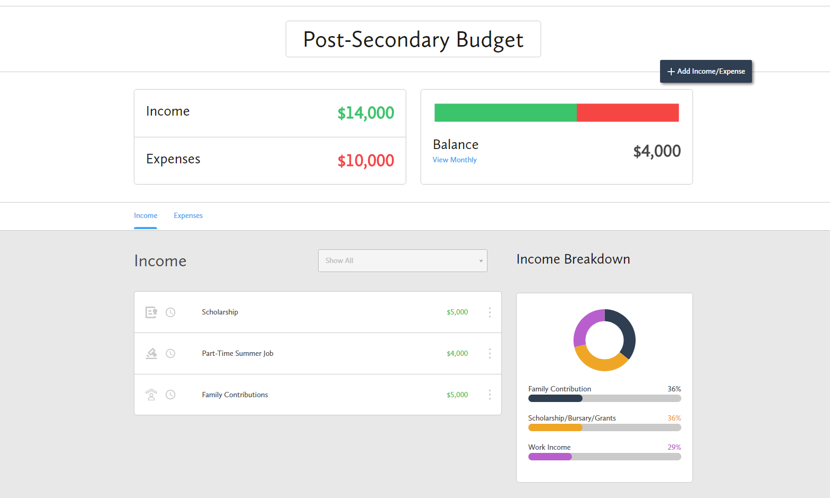
MONEY

Slide 24
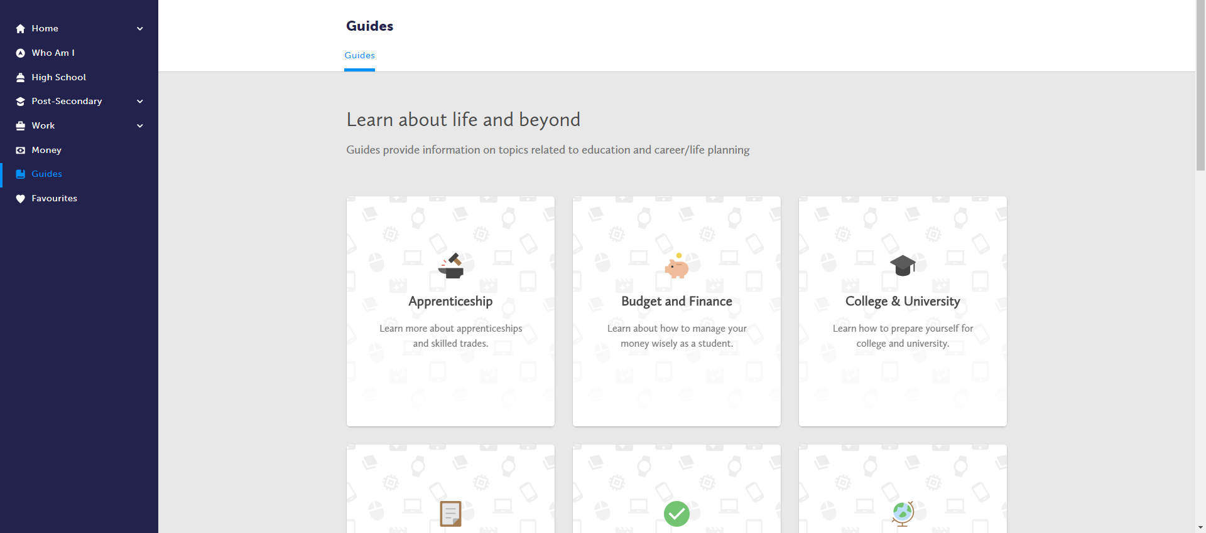
GUIDES

Slide 25
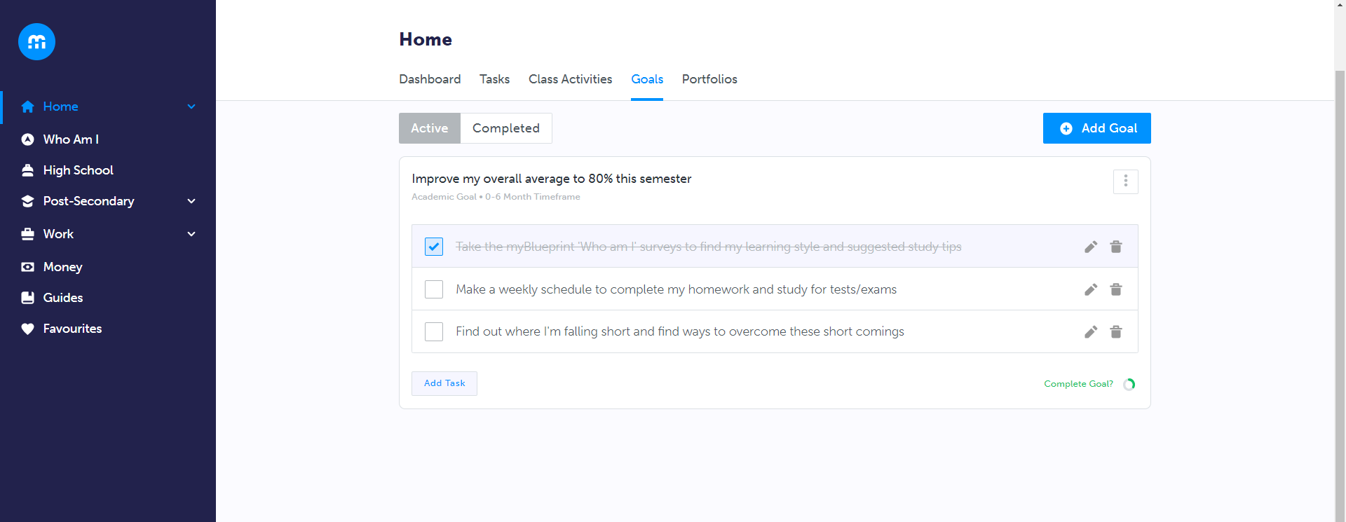
HOME  GOALS

Slide 26
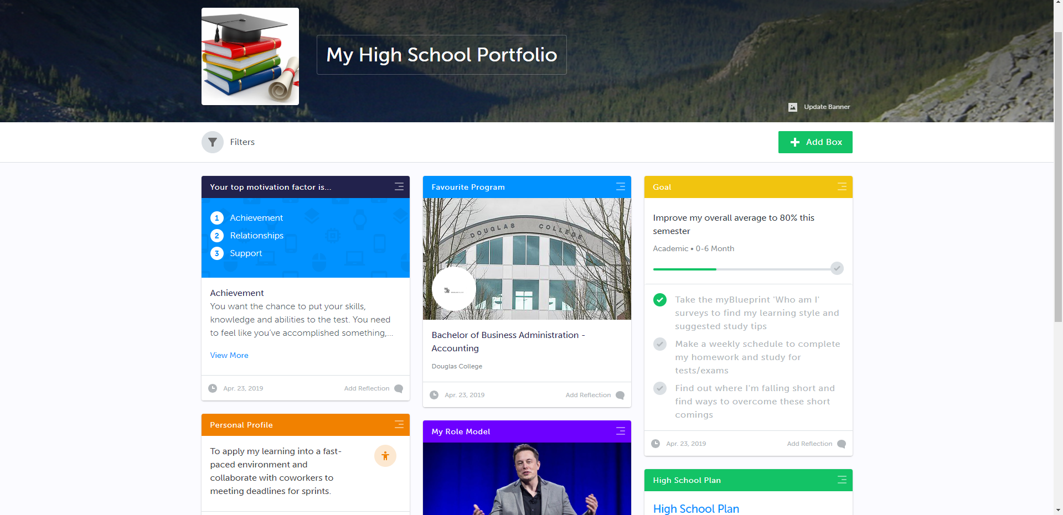
HOME  POTFOLIOS

Slide 27
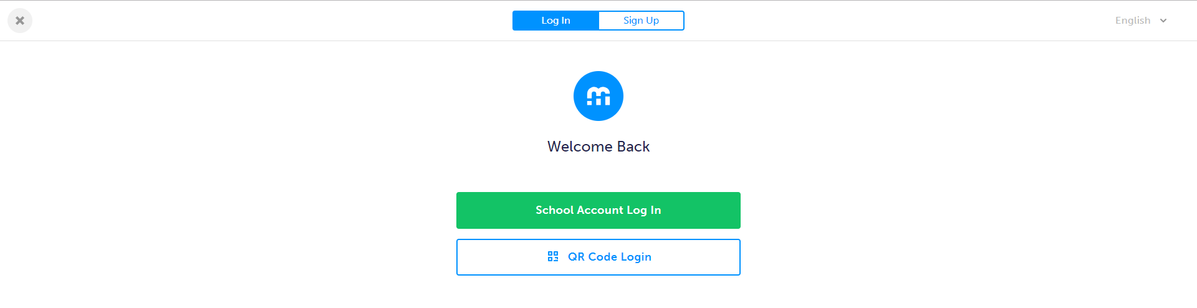
SIGN UP TODAY
1. Visit: www.myBlueprint.ca/sd35
2. Click School Account Log In button
3. Log in with SD35 credentials

Slide 28

“I LOVE myBlueprint! It's so AWESOME, you get to lay everything out and see your plan clearly... Thanks for making planning soooooo easy! :D”
@my_Blueprint

